Slide 1
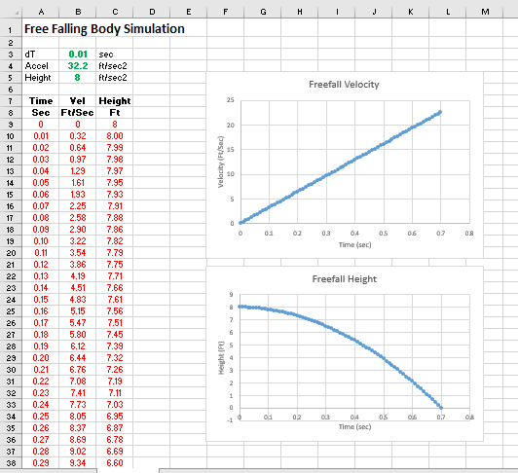
Free Falling Body Simulation
Instructions on how to write a simple spreadsheet simulation to predict the motion of a free falling object.

Slide 2
It is not particularly difficult to predict the impact velocity and the fall time of a free falling body. It can be done using 3 simple equations based on Newton’s 2nd Law of Motion. That said, you might conclude that a simulation is a little bit of over kill.
That might be true, but the real value of understanding this simple “simulation” is that is serves as the computational basis for more complicated simulations such as pendulum motion, projectile motion, and even model rocket flight. So, what better way to understand the basics than by starting with the simplest example.
This presentation deals with writing the simulation in a spreadsheet format and doesn’t address the “physics” of the problem. To understand the physics please refer to the companion lesson on Free Falling Body Physics.

Slide 3
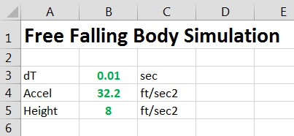
Input Table
As with all simulations, the first step is to create a table of input data. The physics and computational approach behind this simulation requires only 3 inputs.
The “dT” is the integration time step. In this case, a calculation is made for every 0.01 sec of motion.
The “Accel” is the acceleration due to gravity. This simulation is based on English units. 32.2 ft/sec² represents Earth, but you could use moon gravity, Mars gravity, and Saturn gravity, etc.
The “Height” is simply the height from which the object is dropped. The simulation ends when the object’s height becomes zero (i.e. hits the ground)
NOTE: GREEN numbers denote values that can be changed by the user. RED test is calculated data. These visual cues help prevent overwriting equations… You could also “lock” cells to prevent messing things up…

Slide 4
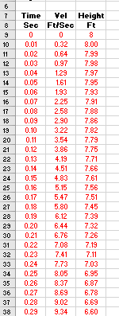
Output Table
For this simulation only 3 outputs are needed.
“Time” starts at zero just as the object is released. The value of time increases in steps of dT.
“Velocity” is the instantaneous velocity of the object as it falls. Since drag is not considered in this simulation, this value will always increase.
“Height” is the instantaneous height of the object above the ground (“simulated ground” that is). Height will start at the value defined in the input table and will decrease with time.

Slide 5
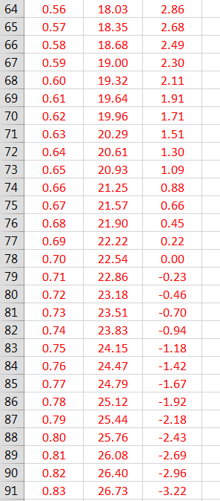
One of the problems with using a spreadsheet for making a simulation is that it doesn’t know when to “stop”. If you don’t include enough computational rows, the height data will never reach zero (the typical stopping point). If you have too many computational rows, the height will eventually become negative. This is not a problem with the computational approach, its just an artifact of using a spreadsheet instead of using some sort of programming language such as C++.
Either delete the rows with negative data of just ignore it. When plotting the data, adjust the data set to only include heights above zero.

Slide 6
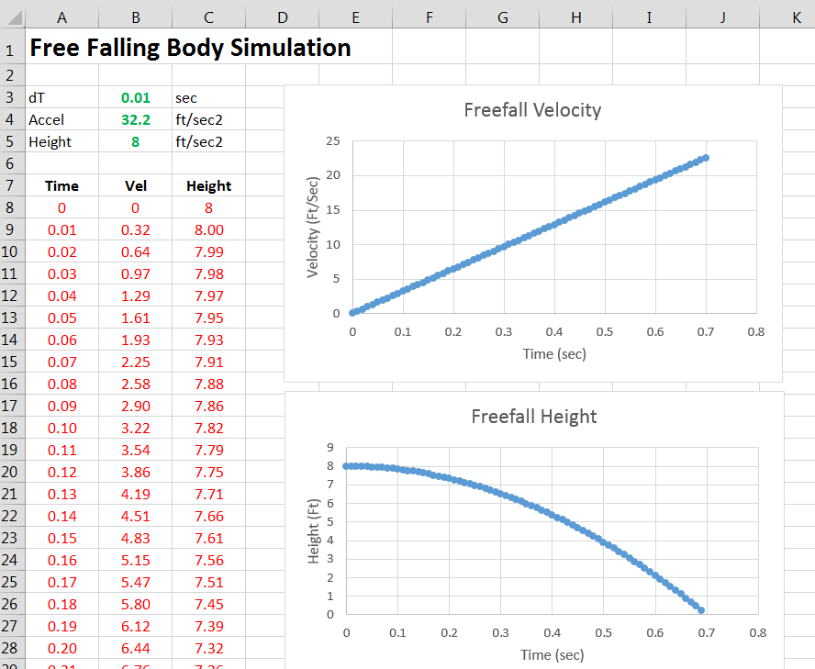
Data Plots
The best way to examine the data is to plot it – its much easier to see if something strange is going on with the simulation.
Again, this simulation isn’t very complicated so plots aren’t critical, but as the simulations become more complex, plots are critical to assessing the information.

Slide 7
It is assumed that the student understands the basics of using a spreadsheet, but clarifying descriptions are provided in this presentation to assist the novice.
This simulation performs the “numerical integration” using the Euler method. Refer to the LabRats Lesson on Numerical Integration for a detailed explanation of what is meant by “integration” and how it is accomplished using a computer.
The student should also examine the LabRats Free Fall Physics Lesson to understand the math and science behind the simulation.
This lesson provides the information need to develop a simple simulation of a free falling body (i.e. a ball)… Let’s dive into the details…

Slide 8
The following slides identify the equations that are used in the simulations. The format used to convey this information is as follows:
Designates the COLUMN where the info is to be entered
B
10 = (A2 * 100) / (C7)
The text or equations in the cell
NOTE: Make sure you enter the information of equations on the cells designated. If you don’t, the simulations won’t work since the equations reference specific cells…
Designates the ROW where the info is to be entered

Slide 9
Let’s look at the first ROW of the output table. The output table is actually where all of the spreadsheet calculations are made.
Row 9 (First line of the computations):
This represents Time = 0 (the time just when the object is dropped). This line is generally mostly zeros or an echo of some of the input data (i.e. Height).
A B C
9 0 0 = B5
Recall from the input table that B5 is the starting height…

Slide 10
Row 10 is where the computations really begin. Let’s look at the equations in each of the columns.
Column A (Time):
This is the accumulated time of the simulation. It is calculated by adding the “Time Step” to the accumulated time from the previous row.
Time_{new} = Time_{previous} + Time Step
A
10 = A9 + $B$3
Once we get the first computational line of code written, we will simply copy and paste the row to the lower rows. This will save a huge amount of time. When we do this, the spreadsheet automatically changes the row and column designations in the equations. If we don’t want the row/column to be used in the equations to change as we copy and paste, we need to use the “$” to tell the spreadsheet to always use a fixed cell. For example, when we copy and paste the cell calculating accumulated time, we want to always use the Time Step in cell B3, so we need to designate it as $B$3.
This is the time from row 9…

Slide 11
Before we move on to the next column, it might be good to review some basic free-falling physics. When drag is neglected, a body falls at a constant acceleration. In the case of this simulation we are assuming 32.2 Ft/Sec².
This simulation uses a simple Euler numerical integration scheme to calculate the velocity and distance based on the instantaneous acceleration of the body. In the case of the free falling body, the instantaneous acceleration is a constant 32.2. Since it is constant, it doesn’t make a whole lot of sense to display it for every time step. However, in more complex simulations, instantaneous acceleration changes over time and it should be displayed.
Now on to calculating the velocity and height of the falling object…

Slide 12
Column B (Velocity):
This is the accumulated velocity of the falling object. It is calculated by adding the “change in velocity” during the small sliver of time (dT) to the accumulated velocity from the previous row.
Velocity_{new} = Velocity_{previous} + (Acceleration x dT)
B
10 = B9 + ($B$4 * $B$3)
Notice that this equation uses the constant Acceleration and constant dT (i.e. they don’t change with time). As such, we use the “$” designation so the cells don’t change when rows are copied and pasted.

Slide 13
Column C (Height):
This is the accumulated height of the falling object. It is calculated by subtracting the distance the object has fallen during the small sliver of time (dT) from the height in the previous row.
Height_{new} = Height_{previous} - (Velocity x dT)
C
10 = C9 + (B9 * $B$3)
In this cell, the velocity does change with time, and thus we need to use a value from the previous row (B9). As such, we don’t use $B$9… However, we are still using the “fixed” time step dT, so we use $B$3 so the same cell is used even when we cut and paste subsequent rows.

Slide 14
The cells in the computational portion of the spreadsheet should look like the following:
A
B
C
10
= A9 + $B$3 | = B9 + ($B$4 * $B$3) | = C9 – (B10 * $B$3)
If you are inexperienced in using spreadsheets this can be a little confusing. Just remember, in reality the equation in the first column is actually saying A10 = A9 + $B$3…

Slide 15
Now its just a matter of copying ROW 10 into ROW 11, then into ROW 12 and so on. This can be done in one fail swoop.
Highlight an area 3 columns wide (Columns A, B & C in this case) in Row 10 by putting the cursor on Column A, then left click and hold, then move the cursor over to Column C
Then right click and select “Copy”
Move down to Row 11 and highlight the same 3 columns, but then drag the cursor down to highlight another 80 rows.
Then right click and select “Paste”
You should notice that those 80 rows display data…
If you did everything correctly. You should notice that the height is near ZERO on the last row of data (depending on how many rows you actually copied.) If not, you may have done something wrong…

Slide 16
Verifying Your Simulation
This is not a lesson on how to use a spreadsheet, so there is no detailed explanation on how to create the data plots. However, the user simply needs to highlight the appropriate columns and select the chart type. A “scatter” chart is used here. The user can figure out how to label the graph properly…

Slide 17
Verifying Your Simulation
This is the fun part… Before you can use your simulation to predict the behavior of a free falling object, you need to make sure it is working correctly. The best way to do this is to conduct an experiment.
Use a stopwatch (or your phone) to measure the time is take a ball hit the ground when dropped from a height of 8 feet (or whatever the initial height is in your simulation). Since you may not start and stop the clock exactly at release or impact, conduct 5 or 10 drops and take an average of the results. Is your simulation matching the experiment? If not, you need to look for bugs in your spreadsheet.

Slide 18
Congratulations, you have written your first computer simulation. You can go to other RatLab Lessons and develop more complicated simulations including, a pendulum, a projectile, and even a simple model rocket.
If you hope to enter engineering school someday, this knowledge will come in handy…

